Slide 1
MAP DISCUSSION - 30 January 2024
30 January 2024

Slide 2
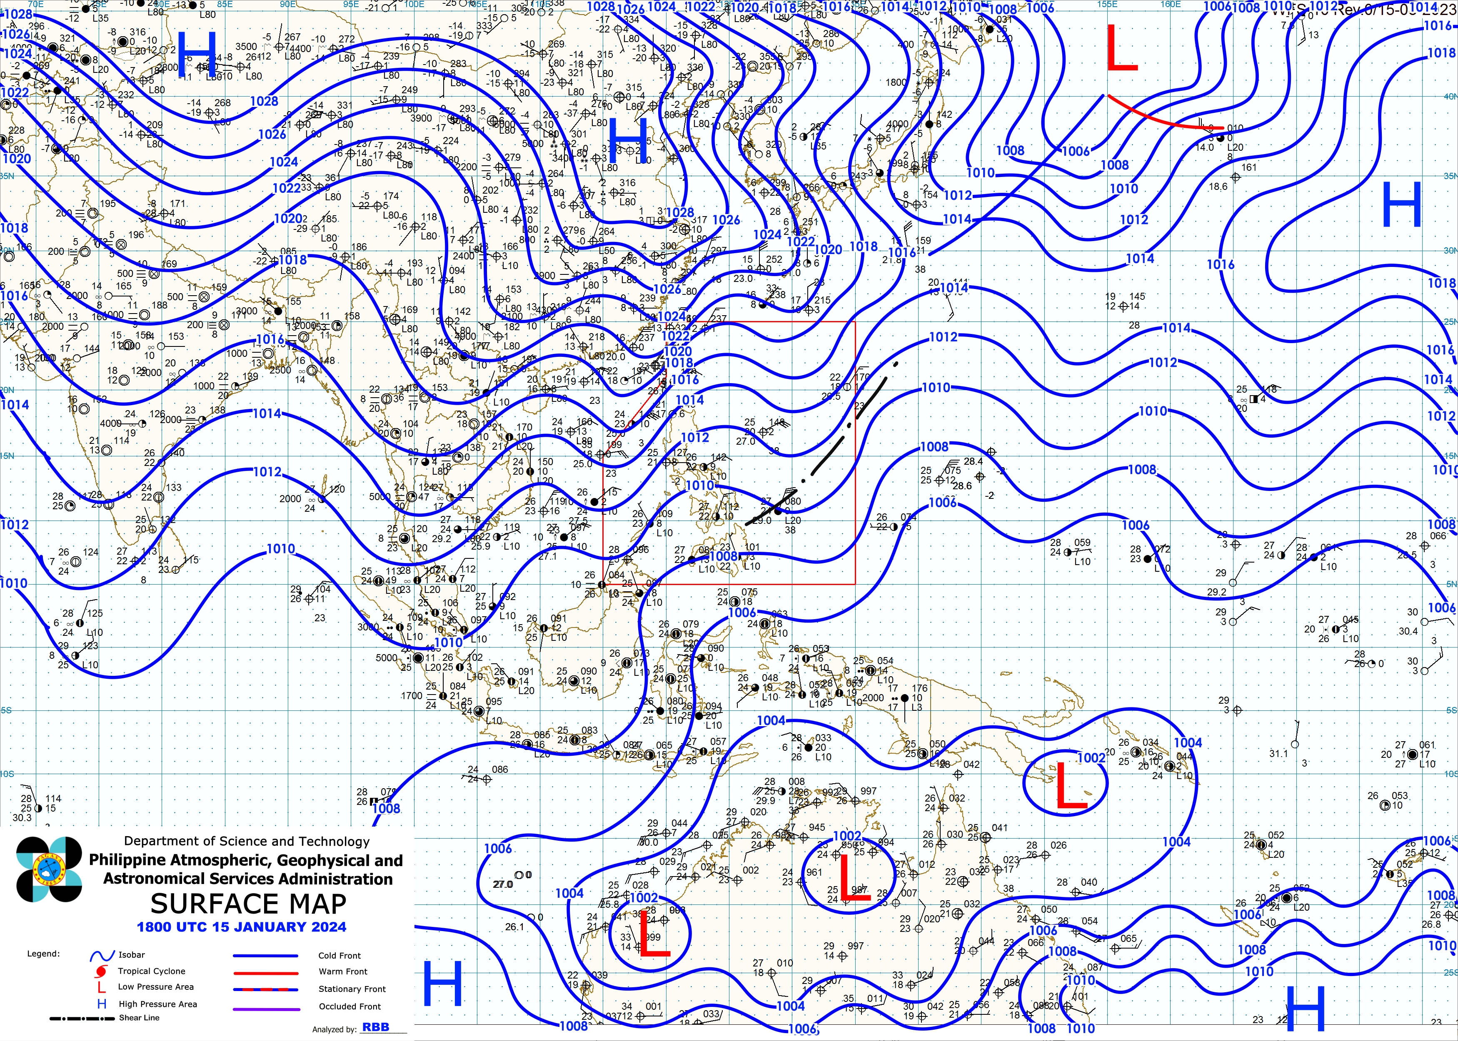
Surface Chart, 00Z - 29 January 2024

Slide 3
Surface Chart, 06Z - 29 January 2024

Slide 4
Surface Chart, 12Z - 29 January 2024

Slide 5
Surface Chart, 18Z - 29 January 2024

Slide 6
Surface Chart, 00Z - 30 January 2024

Slide 7
(TMD) Surface Chart, 00Z - 30 January 2024

Slide 8
(JMA)Surface Chart, 00Z - 30 January 2024

Slide 9
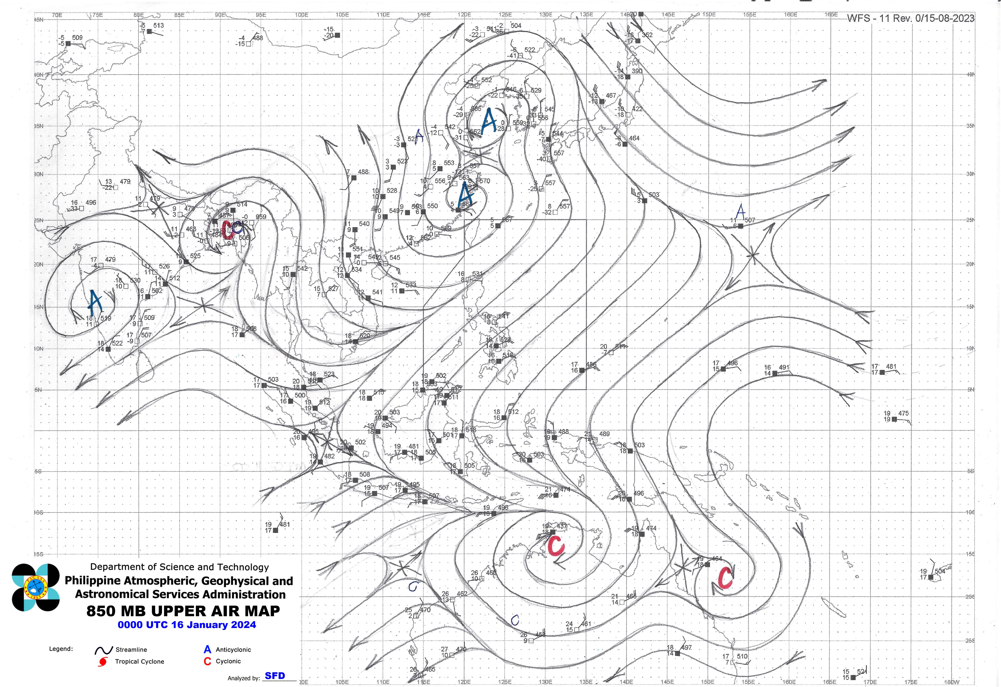
Upper Air Chart, 850MB, 00Z - 30 January 2024

Slide 10
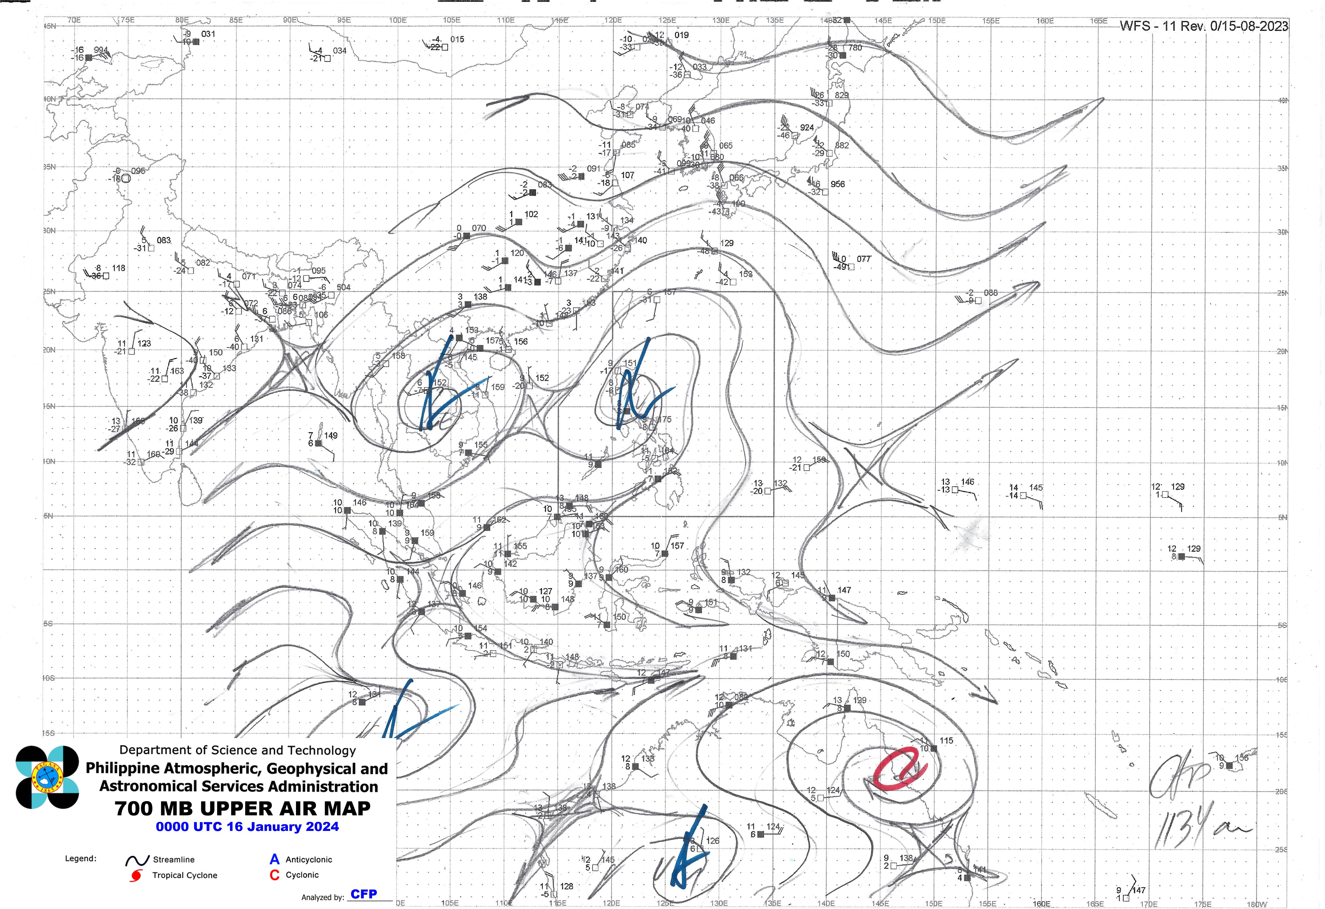
Upper Air Chart, 700MB, 00Z - 30 January 2024

Slide 11
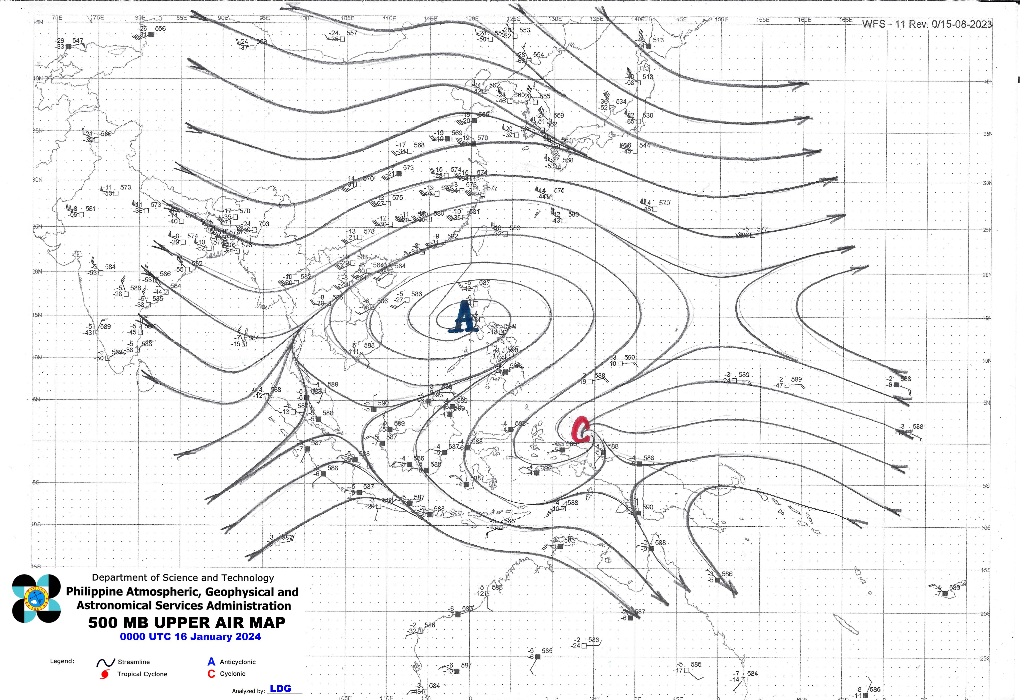
Upper Air Chart, 500MB, 00Z - 30 January 2024

Slide 12
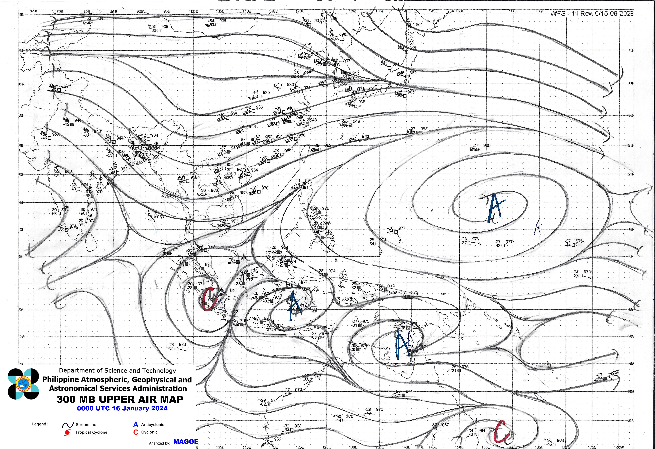
Upper Air Chart, 300MB, 00Z - 30 January 2024

Slide 13
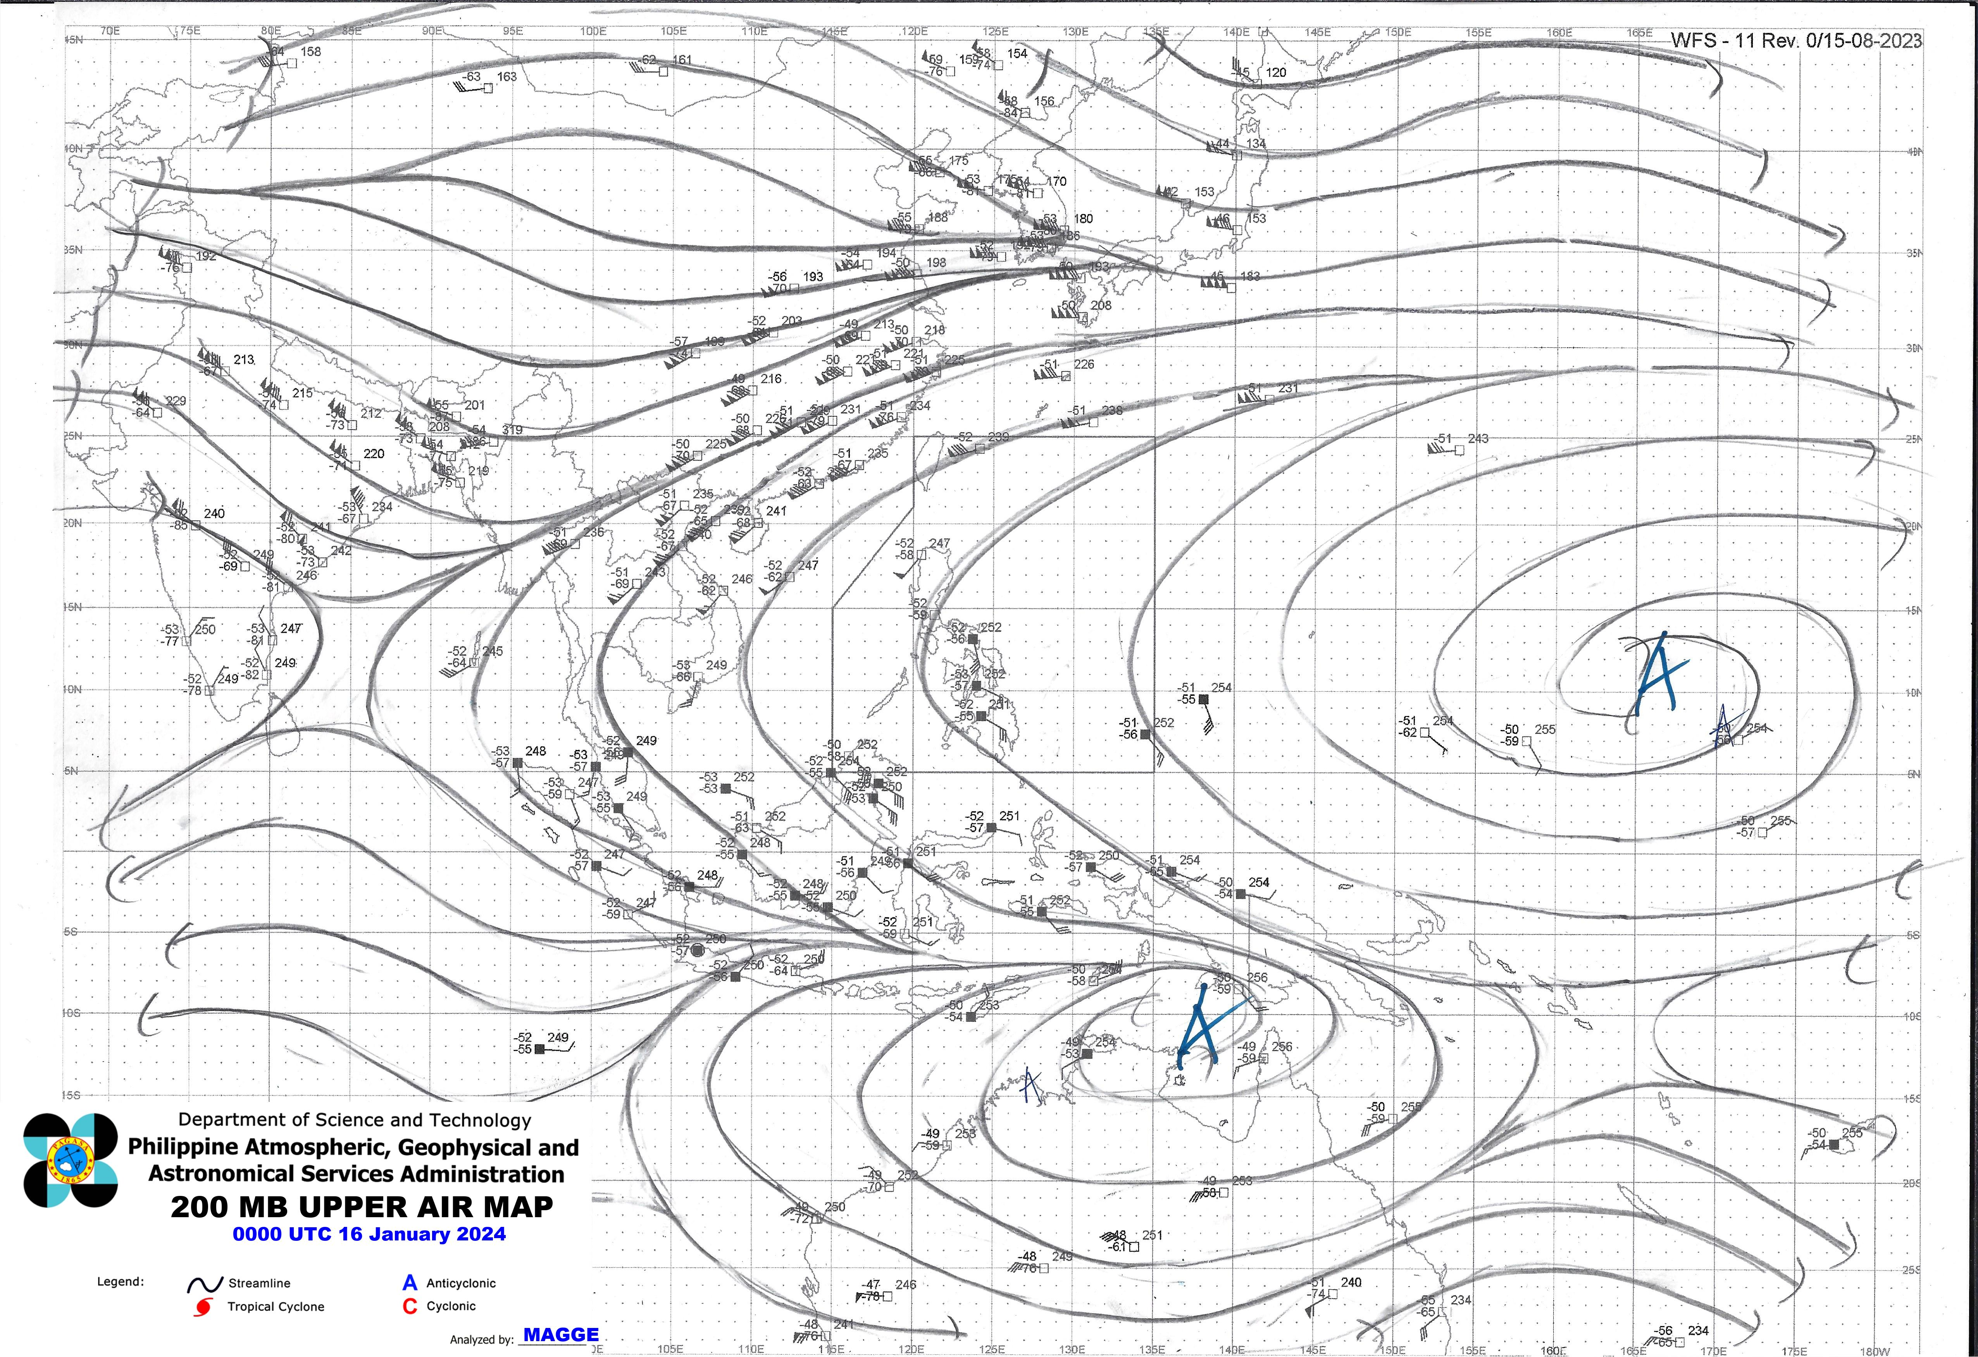
Upper Air Chart, 200MB, 00Z - 30 January 2024

Slide 14
Suggested Scenario - 30 January 2024

